Slide 1
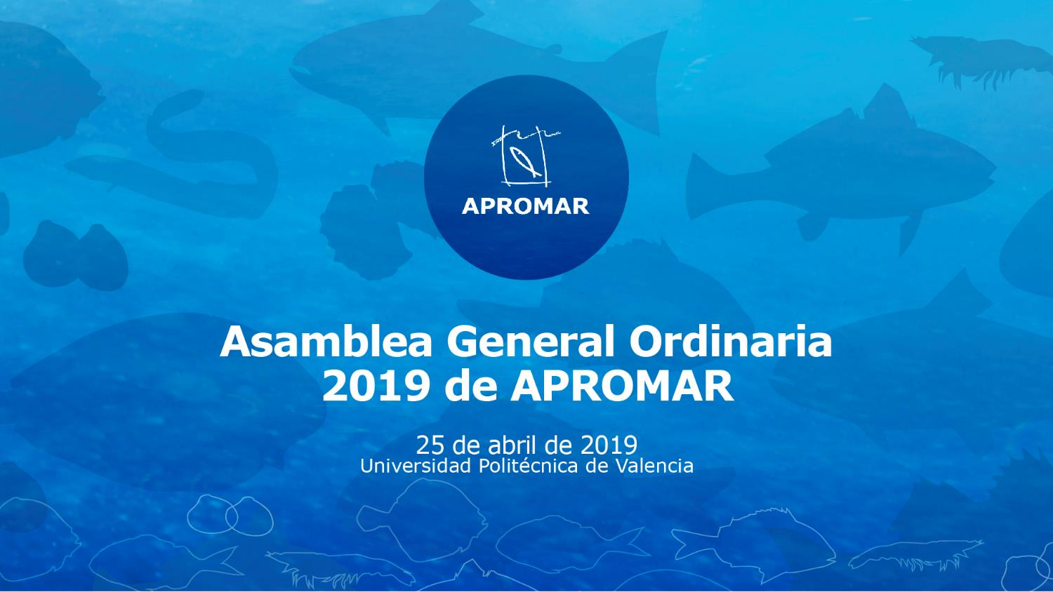
Chiclana. Spain. 24-25/06/2019
Visit of Mugla Fish Farmers Association to APROMAR

Slide 2
Visit’s programme

Slide 3
Programme
Day 1 Monday June 24th (Monday)
10:30h a 12:30h – Meeting in APROMAR’s office
12:30h a 13:00h – Car travel to Puerto Real area
13:00h a 14:00h – Visit of MTA (multitrophic fish farm) in Puerto Real
14:00h a 14:15h – Car travel to El Puerto de Santa María area
14:15h a 16:00h – Lunch in El Puerto Santa María
16:00h a 16:15h – Car travel to a CTAQUA
16:15h a 18:00h – Visit to CTAQUA (research/technology centre) and meeting

Slide 4
Programme
Day 2. June 25th (Tuesday)
10:00h to 12:00h - Meeting in APROMAR’s office
12:00h to 12:30h – Car travel to Trebujena (confirmation pending)
12:30h to 14:00h – Visit to a land based fish farm Pistresa in Trebujena
14:00h to 15:30h - Lunch

Slide 5
Aquaculture in Spain

Slide 6
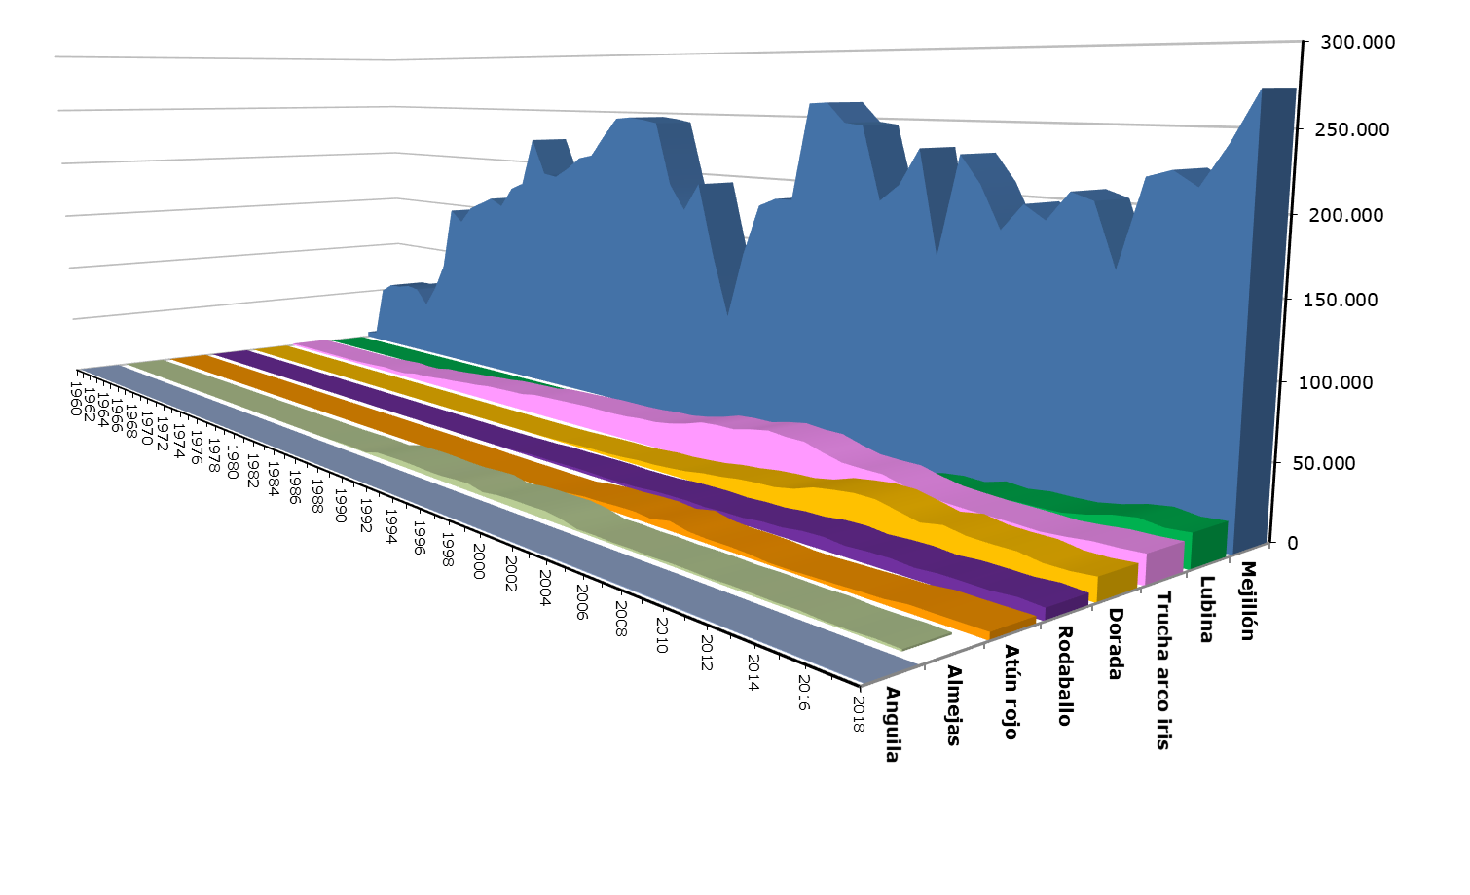
Aquaculture in Spain (volume)

Slide 7
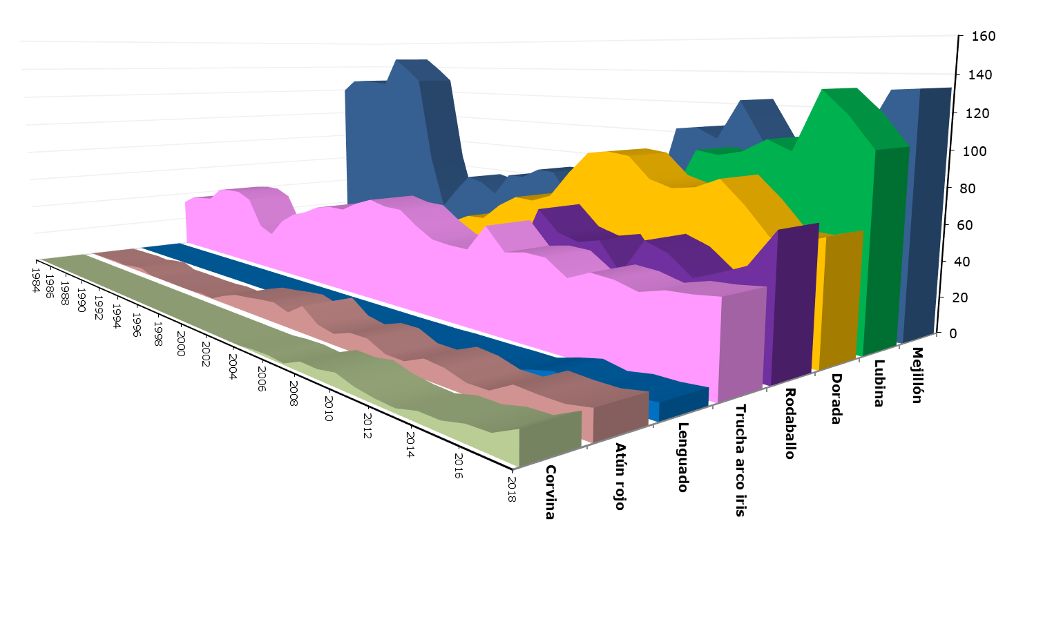
Aquaculture in Spain (value)

Slide 8
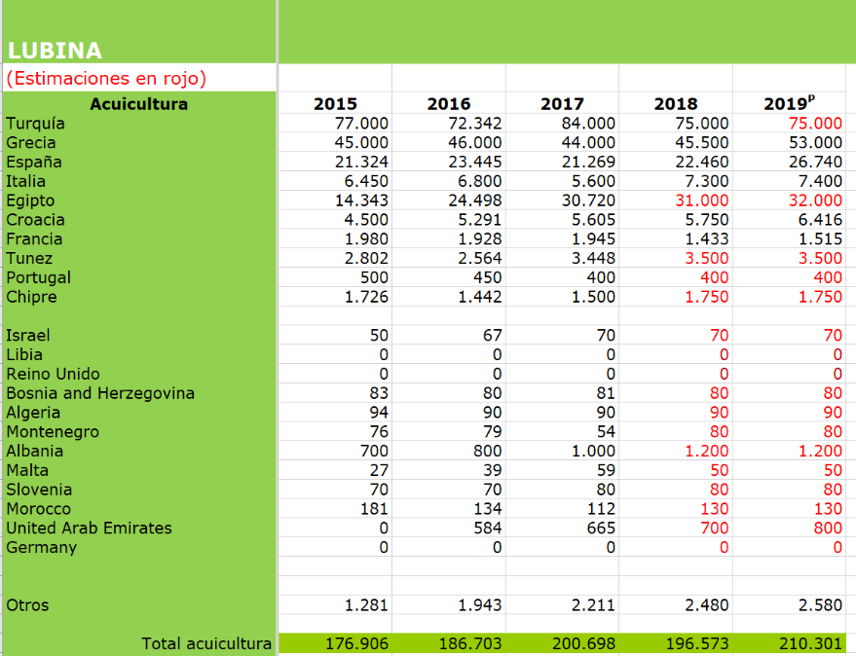
Aquaculture in Spain

Slide 9
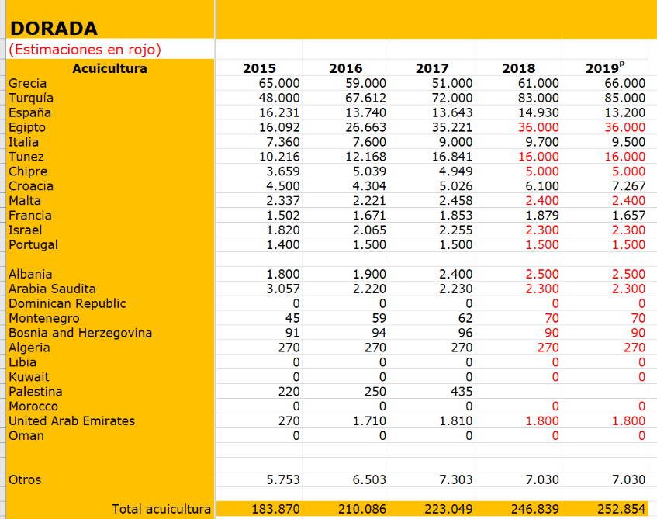
Aquaculture in Spain

Slide 10
Location and meeting plan

Slide 11
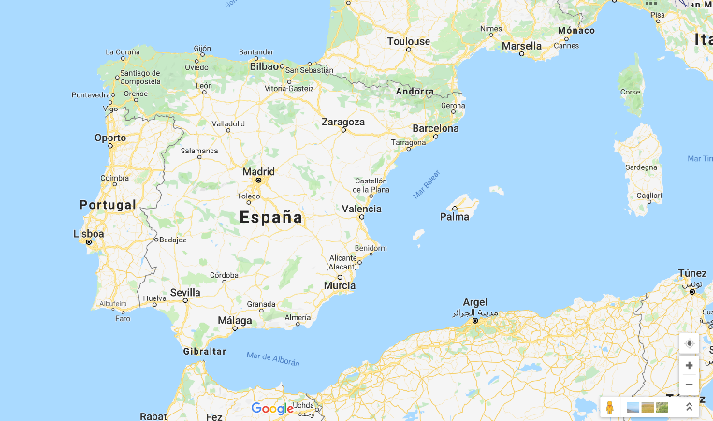
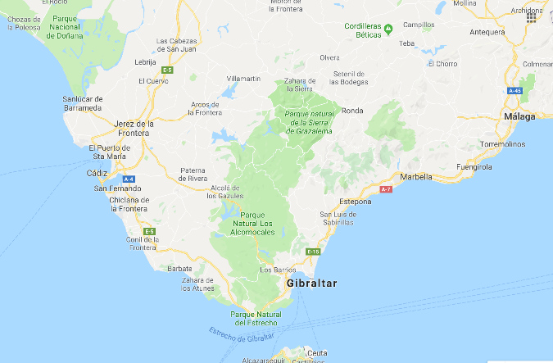

Location

Slide 12
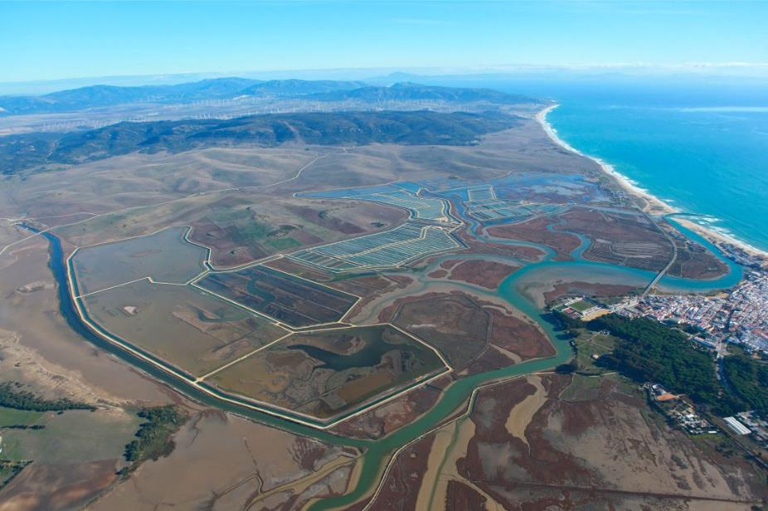
Location

Slide 13
Meeting plan
Day 1 - Meeting in APROMAR’s office June 24th (Monday)
10:30h a 12:30h
Review and description of APROMAR’s activities
Review and description of MFFA’s activities
Day 2 - Meeting in APROMAR’s office June 25th (Tuesday)
10:00h to 12:00h
Debate on collaboration possibilities.
Debate on common actions and activities.

Slide 14
Review and description of APROMAR

Slide 15

APROMAR
APROMAR is the Spanish Aquaculture Farmer’s Association [Since 1986].
Also recognized as a European Producer’s Organisation (PO nº30).

Slide 16
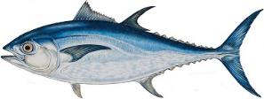
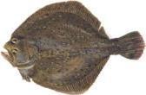
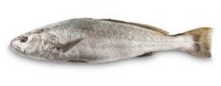





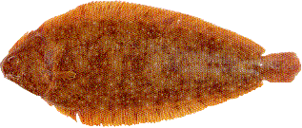


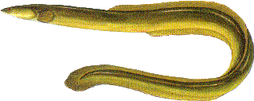
APROMAR
The members of APROMAR are aquaculture farming companies that produce aquatic animals or algae in Spain. The great majority of Spanish aquaculture companies are members of APROMAR (except mussels).
Regional Aquaculture Associations are also members.
And companies that are suppliers of goods and services for aquaculture.

Slide 17
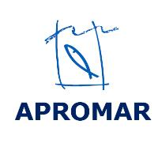



What is a business association?
A venture in which companies join efforts for a common purpose and that is endowed with a legal personality.
The overarching objective is to obtain an individual benefit through sectoral cooperation.
APROMAR’s business associations structure:

Slide 18
Objectives of APROMAR
Improve the competitiveness of our members.
Promote the sustainable development of the aquaculture sector.
Categories of members of APROMAR
Aquaculture producers
Regional associations
Observers

Slide 19
Structure of APROMAR
General Assembly
Board of Directors
Secretariat
Focus groups
Focus groups
Focus groups

Slide 20
Connections of APROMAR (Private Spain)
FIAB
APROMAR
IEO
IBERAVAL
Trade Unions
Research centres
CEOE
PTEPA
Vet + i
FEADSA

Slide 21
Connections of APROMAR (Public Spain)
APROMAR
Ministries
Region Gov.
INTERPR.
AGROALIM.
JACUMAR
SGP
CES

Slide 22
Connections of APROMAR (International)
APROMAR
AAC & MAC
EESC
European Commission.
EU Parliament
FAO
FEAP
IUCN

Slide 23
Assets of APROMAR:
The capacity to influence in the decisions of other organisations (public or private) → lobbying effectiveness.
To be a community to share ideas and create opinions.
To be an information hub and source of sectorial knowledge.
The possibility to act as enabler to achieve results.

Slide 24
The keys to the “success” of APROMAR:
The industry
The (relatively) large size of the Spanish aquaculture industry.
The high representativeness of APROMAR within the industry.
APROMAR’s good reputation and credibility.
The association
An impartial and dedicated Board of Directors.
Fair internal governance and transparency.
Good communication (internal and external).
Professional management team for the association.
Internal quality discussions and agreements. (Toxic debates are left outside).

Slide 25
Challenges of the industry and of APROMAR:
External
Complexity of public administrative procedures.
Difficulty to obtain new fish farming licenses.
Gaining social acceptance for the aquaculture activity.
Improving the reputation of aquaculture products.
Improving the efficiency of the farming of fish.
Innovation and technology improvements.
Internal issues
Financing: Striking the right balance between internal and external funding.

Slide 26
APROMAR’s activities

Slide 27

Activities of APROMAR: FISH HEALTH
Establishment of FEADSA and a network of ADS
ADS = Association for Animal Health Protection (per region).
FEADSA = Federation of ADS (National).
Each ADS with a veterinarian that freely accesses all farms in the region.
Common fish health protection plans
Communication of disease outbreaks between members.
Communication with public authorities.
FEADSA: Lobby and recommendations at national and EU level.

Slide 28
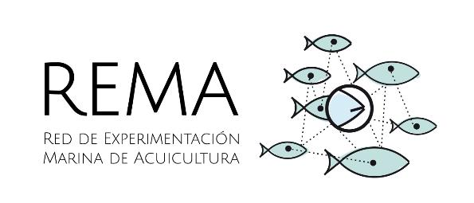
Activities of APROMAR: INNOVATION
Establishment of REMA
REMA = Network of Innovation for Aquaculture (National).
Technical Committee with the participation of farming companies directors (production/quality/innovation).
Design and development of innovation projects.

Slide 29
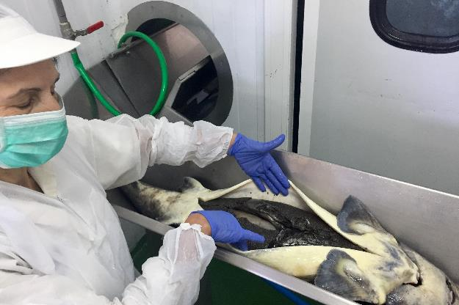
Activities of APROMAR: COLLECTIVE LABOUR AGREEMENTS
Negotiation with Trade Unions minimum standards on working conditions in aquaculture farms:
  Working time.
  Working shifts.
  Salaries.
  Workers categories.

Slide 30
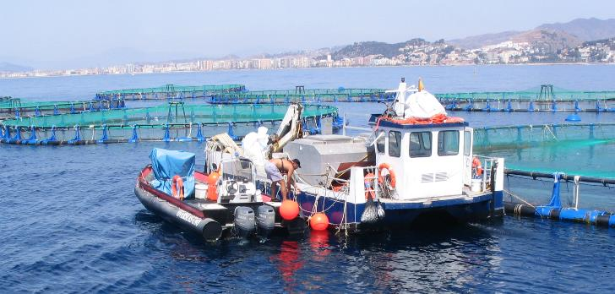
Activities of APROMAR: WORKERS SAFETY
Development of research projects on workers health and safety.
Education.
Training.

Slide 31
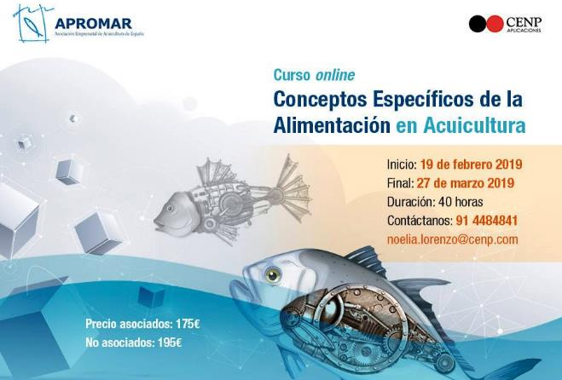
Activities of APROMAR: TRAINING
Design and development of training courses.
Life-long training.
On-the-spot and online.
  Fish feeding.
  Fish health.
  Fish welfare.
  English, Office,
  Management, etc.

Slide 32
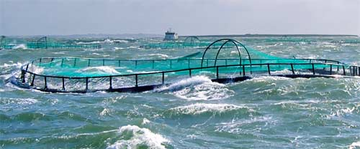
Activities of APROMAR: INSURANCE
Provide consultation and support for the Spanish Agricultural Insurance Public Scheme (ENESA-Agroseguro).
  Consultation and lobby.
  Consultation.
  Workshops.
  Legal support.
Provide contact to
private insurance
companies.

Slide 33





Activities of APROMAR: COMMUNICATION
Offer sound information to the media and society.
React to negative news.
Social Networks.
Annual report.
Press releases.
Participate in conferences and workshops.

Slide 34
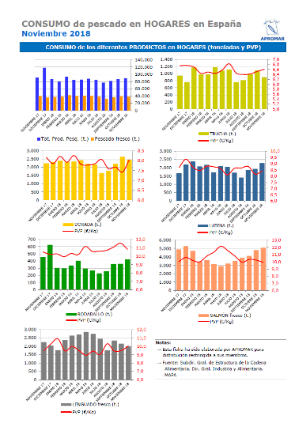
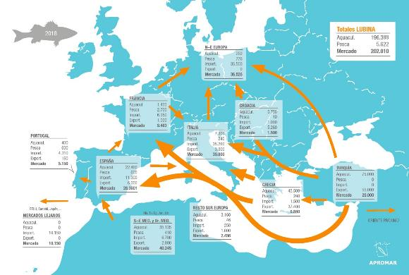
Activities of APROMAR: MARKETS & TRADE
Market intelligence and analysis.
Production, trade and markets.
Legal defence against unfair competition.

Slide 35
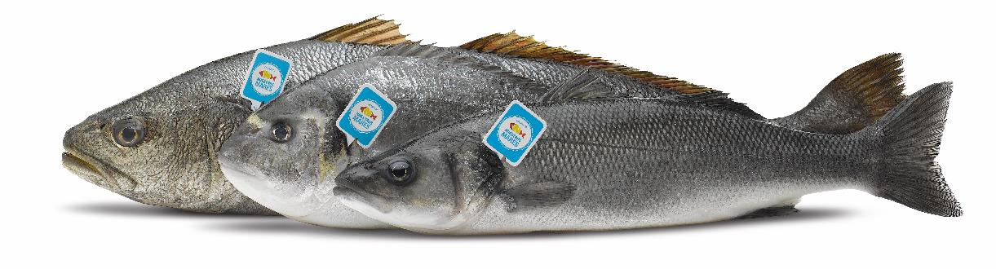
Activities of APROMAR: PROMOTION
Creation of a private collective brand to promote local farmed fish.
Product differentiation: Crianza de Nuestros Mares.
Well focused promotion campaigns.
Yearly repetition of the campaigns until achieving results.

Slide 36
Our present framework

Slide 37


Our present framework
Sustainable development.
Agenda 2030 & the 17 SDG

Slide 38
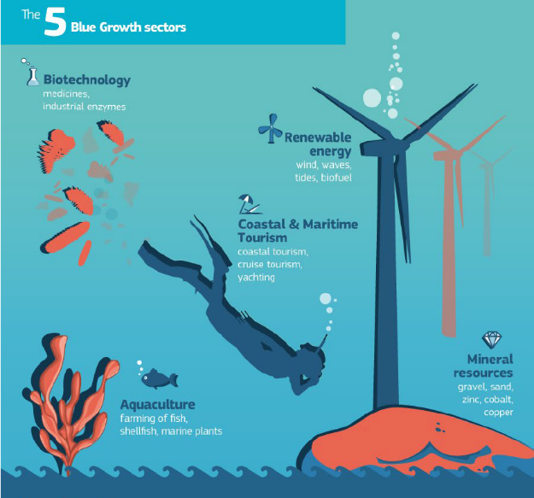
Our present framework
Blue Growth

Slide 39
Our legal framework

Slide 40
Aquaculture legal framework
EU Fisheries policies
Common Fisheries Policy.
Common Market Organisation for Fisheries and Aquaculture products.
European Maritime Fisheries Fund.
Food safety
Food Hygiene: Food Laws: Regulation 178/2002. Principles and general requisites of food legislation. Regulation 852/04 Hygiene for food products. Regulation 853/04. Hygiene for foods of animal origin. Regulation 854/04 Official controls of products of animal origin, for human consumption. Regulation 882/04 Oficial control of feed and food.

Slide 41
Aquaculture legal framework
Environment (Framework Directives)
Habitats
Birds
Marine Strategy (marine waters)
Water (fresh waters)
Spatial planning
Marine Spatial Planning

Slide 42
Aquaculture legal framework
EU Research
Sources of funding for research: Horizon 2020 (Framework Programmes).
Fish welfare
Fish welfare: Regulation 2016/429 and Directive 98/58/EC.
Other laws are at national level.

Slide 43
Aquaculture legal framework
EU Research
Sources of funding for research: Horizon 2020 (Framework Programmes).
Fish welfare
Fish welfare: Regulation 2016/429 and Directive 98/58/EC.
Other laws are at national level.

Slide 44
Research projects

Slide 45



Research projects
Diversify
Exploring the biological and socio-economic potential of new/emerging candidate fish species for expansion of the European aquaculture industry.
PerformFish
Integrating Innovative Approaches for Competitive and Sustainable Performance across the Mediterranean Aquaculture Value Chain.
MedAid
Improving the technical performance of the Mediterranean aquaculture.

Slide 46



But beyond everything, in APROMAR we share a vision and enthusiasm!
Javier Ojeda
APROMAR
ojeda@apromar.es
APROMAR proudly sponsored by:

